Slide 1

Roundtable: Sustainability, Marketing, & Innovation
David J. Hardisty

Slide 2
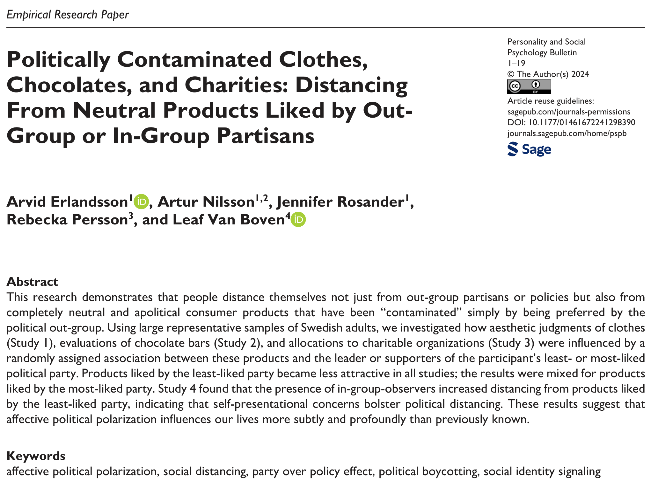

Slide 3
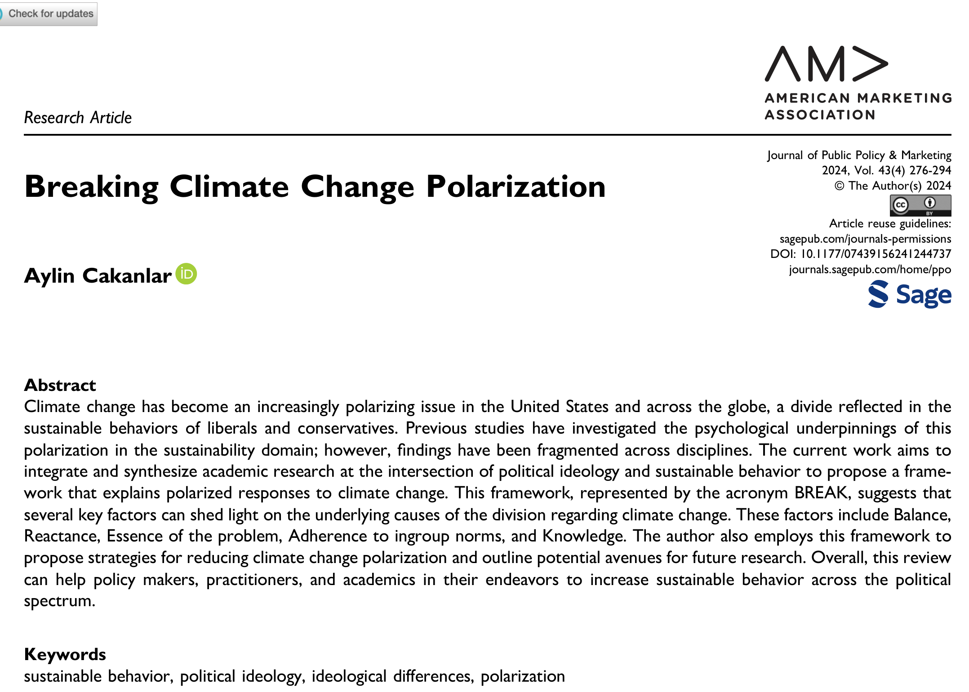

Slide 4
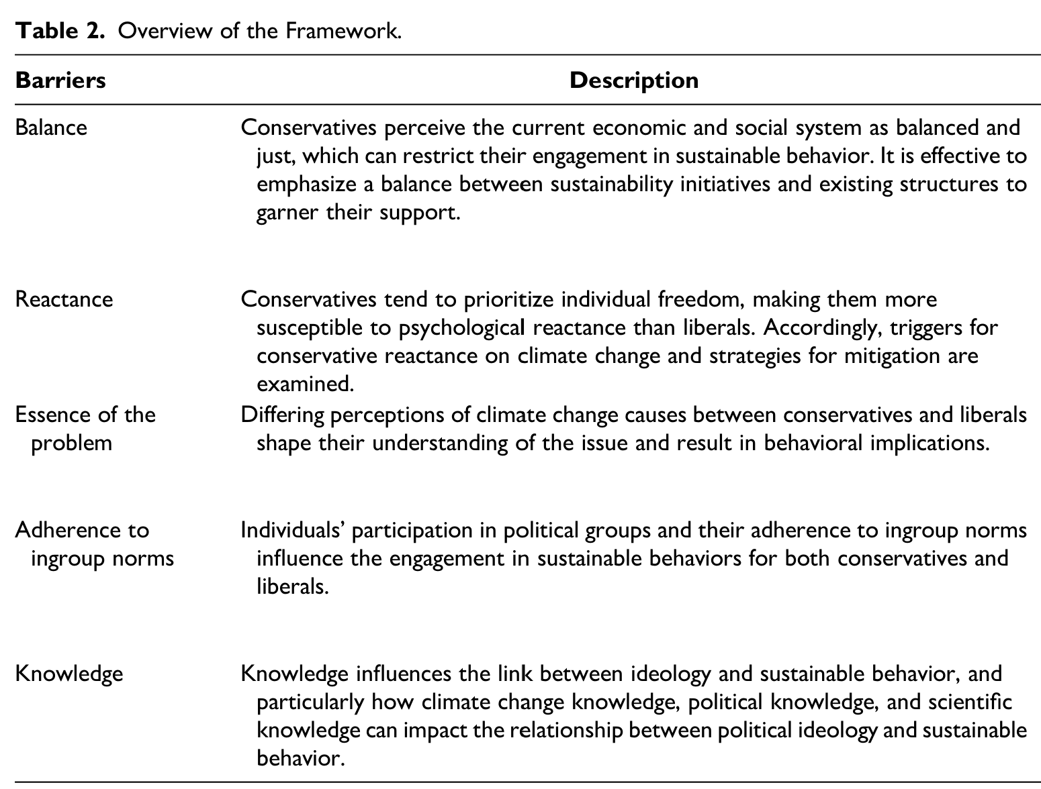

Slide 5
Thank You!

